Slide 1
Power Virtual Agents in a Day
Speaker Name

Slide 2
Agenda
Module | ID | Name | Length
Overview & Setup | 1 | Introductions and pre-requisite | 60 minutes
Module 1 Power Virtual Agent | 2 | Build your first virtual agent | 45 minutes
 | 3 | Create topics from existing webpages | 30 minutes
 | 4 | Improve your virtual agent using entities, variables and topic redirects | 45 minutes
Module 2 Power Automate & other integrations | 5 | Integrate with prebuilt Power Automate flows | 45 minutes
 | 6 | Authentication – no lab | 20 minutes
 | 7 | Hand off to support agent– no lab | 20 minutes
Module 3 Optimization | 8 | Virtual agent topic design | 45 minutes
 | 9 | Best practices for writing topic trigger phrases | 20 minutes
 | 10 | Virtual agent conversation style | 20 minutes
 | 11 | Analytics, monitoring and VA performance improvement | 20 minutes
 | 12 | Closing | 10 minutes

Slide 3


Slide 4
Empower your people to drive more business value through easy to create natural, conversational AI
POWER VIRTUAL AGENTS
Intelligent virtual agents

Slide 5


Microsoft Power Platform
The low-code platform that spans Office 365, Azure, Dynamics 365, and standalone applications
Innovation anywhere. Unlocks value everywhere.
Power BI
Business analytics
Power Apps
Application development
Power Automate
Process automation
Power Virtual Agents
Intelligent virtual agents
Data connectors
Portals
AI Builder
Common Data Service

Slide 6
Complex challenges
66%
90%
59%
try to use self-service first rather than contacting an agent for assistance¹
of customers expect consistency and continuity across channels²
of channels are managed in silos³
Global State of Customer Service, Microsoft
Aberdeen: Empowered Customers Demand a Seamless Experience
Dimension Data: 2017 Global Customer Experience Benchmarking Report

Slide 7
Chat bots can help, but…
Bots are hard to create and expensive to maintain
There is impedance between the subject matter experts with answers – and the developers and scientists who create bots
Bots aren’t useful unless they can integrate with the backend and provide personalized answers

Slide 8
OUR VISION Power Virtual Agents
ENGAGE NATURALLY
DEMOCRATIZE AI
Empower every organization to easily provide delightful, natural interactions with their customers and improve engagement and outcomes
CONTINOUSLY Enhance
TAKE ACTION

Slide 9
Power Virtual Agents is designed for everyone
The chatbot service that enhances everyone’s experience
Your Customers
Subject Matter Experts
IT Admin/Dev

Slide 10
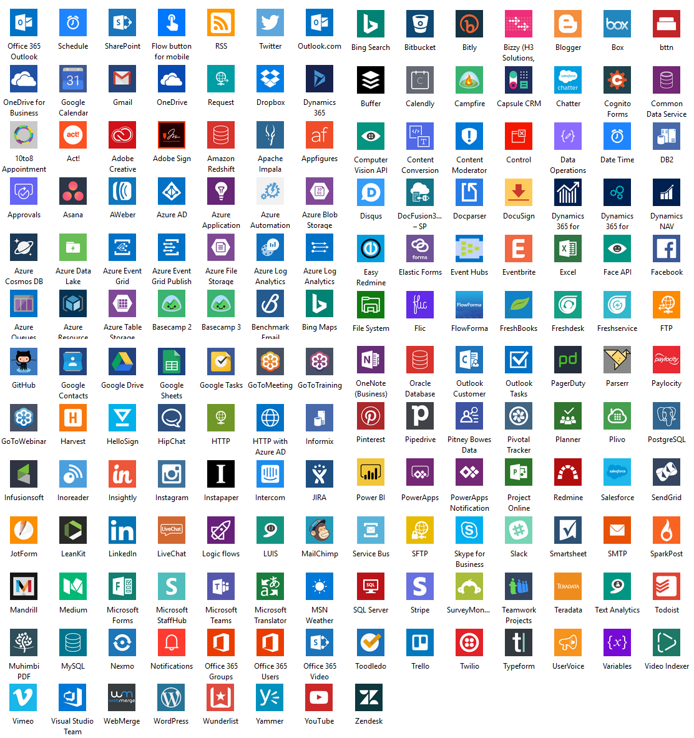
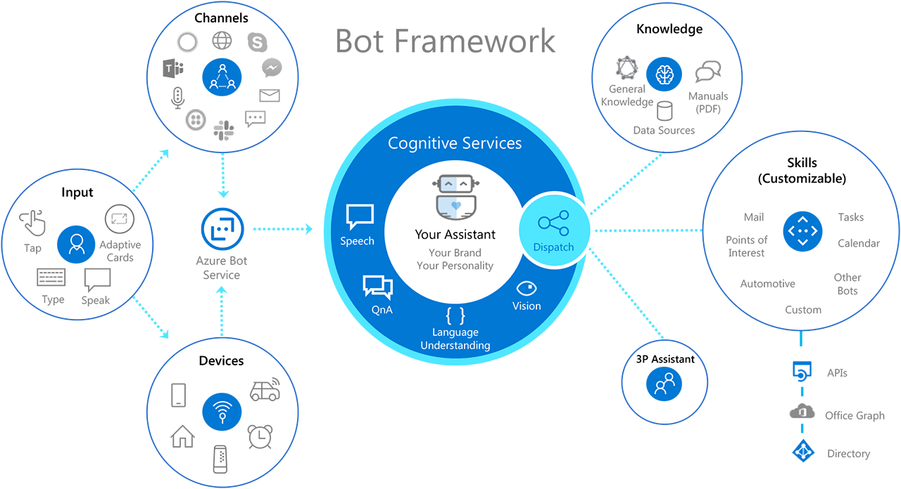
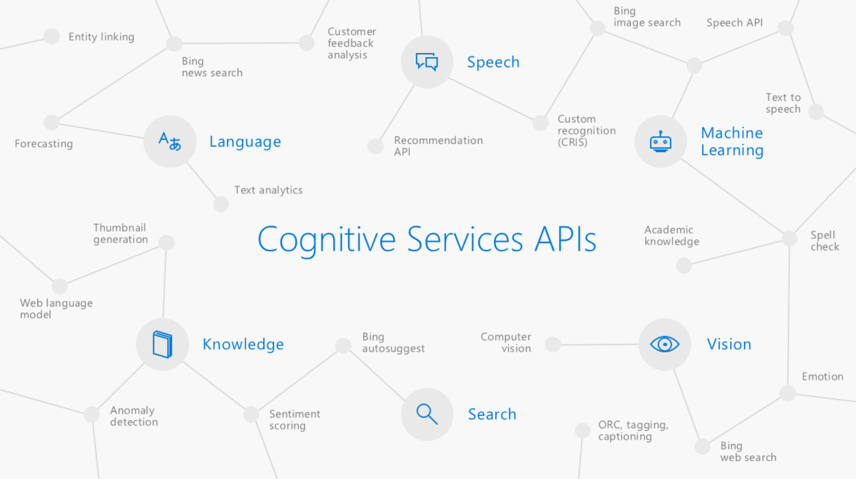
Built on Power Platform & Bot Framework
Access to Flow, custom models through AI Builders and 100s of pre-built connectors
Easy, no-cliff access to the full power of the Azure Bot Framework
Integrated with Azure Cognitive Services
Power Virtual Agents
Azure Cognitive Services
Bot Framework
Power Platform

Slide 11
SECTION SUMMARY
Power Virtual Agents helps support industry trends
Engage Naturally
Democratize AI
Continuously Enhance
Take Action
Designed for Multiple Personas
Customer Focused, Connected, Extensible
Developed on the Microsoft Bot Framework

Slide 12
Lab 01: Prerequisites – Create environment and import solution package

Slide 13
Build your first virtual agent

Slide 14
Agenda
Module | ID | Name | Length
Overview & Setup | 1 | Introductions and pre-requisite | 60 minutes
Module 1 Power Virtual Agent | 2 | Build your first virtual agent | 45 minutes
 | 3 | Create topics from existing webpages | 30 minutes
 | 4 | Improve your virtual agent using entities, variables and topic redirects | 45 minutes
Module 2 Power Automate & other integrations | 5 | Integrate with prebuilt Power Automate flows | 45 minutes
 | 6 | Authentication – no lab | 20 minutes
 | 7 | Hand off to support agent– no lab | 20 minutes
Module 3 Optimization | 8 | Virtual agent topic design | 45 minutes
 | 9 | Best practices for writing topic trigger phrases | 20 minutes
 | 10 | Virtual agent conversation style | 20 minutes
 | 11 | Analytics, monitoring and VA performance improvement | 20 minutes
 | 12 | Closing | 10 minutes

Slide 15
PVA Information Architecture
CDS Environment
PVA BOT (0, 1 or more bots in a CDS environment)
User Topics (1 or M in a bot)
It’s common to have 25+ user topics within a bot. To help you get started the bot comes with 4 pre-defined user topics that you can use or delete. Within each topic you construct a conversation tree.
System Topics (8 pre-defined in a bot)
Includes: Greeting, Goodbye, End of conversation survey etc. Recommend minimal editing e.g., greeting message only. Think of these as building blocks for your conversation.
Conversation Tree (1 per user topic)
Consists of trigger phrases, multiple nodes (message, question, etc.), conditions, the ability to use entities and call actions (flows or skills). You can redirect/call another user topic or system topic from within a conversation tree.
Conversation tree
Consists of trigger phrases, multiple nodes (message, question, etc.), conditions, the ability to use entities and call actions (flows or skills).
Trigger Phrases
(0,1 or more in a user topic)
Trigger Phrases
(read only in system Topics)
(0, 1 or more)
Prebuilt Entities
(0,1 or more)
Custom Entities
(0,1 or more)
Prebuilt Entities
(0,1 or more)
Custom Entities
(0,1 or more)
Power Automate Flows*
(0,1 or more)
Bot Framework Skills
(0,1, or more)
Power Automate Flows*
(0,1 or more)
Bot Framework Skills
(0,1, or more)
*to use Power Automate flows in a PVA bot they must be in a solution, within the same CDS environment as the bot

Slide 16
Bot Creation Process overview
Test your bot
Test your bot
Publish your bot
Create new conversation
Publish your bot
Revise conversation
Measure your bot performance
Measure your bot performance
Create new topics
Revise topics
Create new bot
Revise bot
Notes:
Creating a bot is an easy step by step process. Each chatbot also has performance analytics to enable a feedback loop so you can continuously and easily enhance your chatbot to optimize the customer experience.

Slide 17
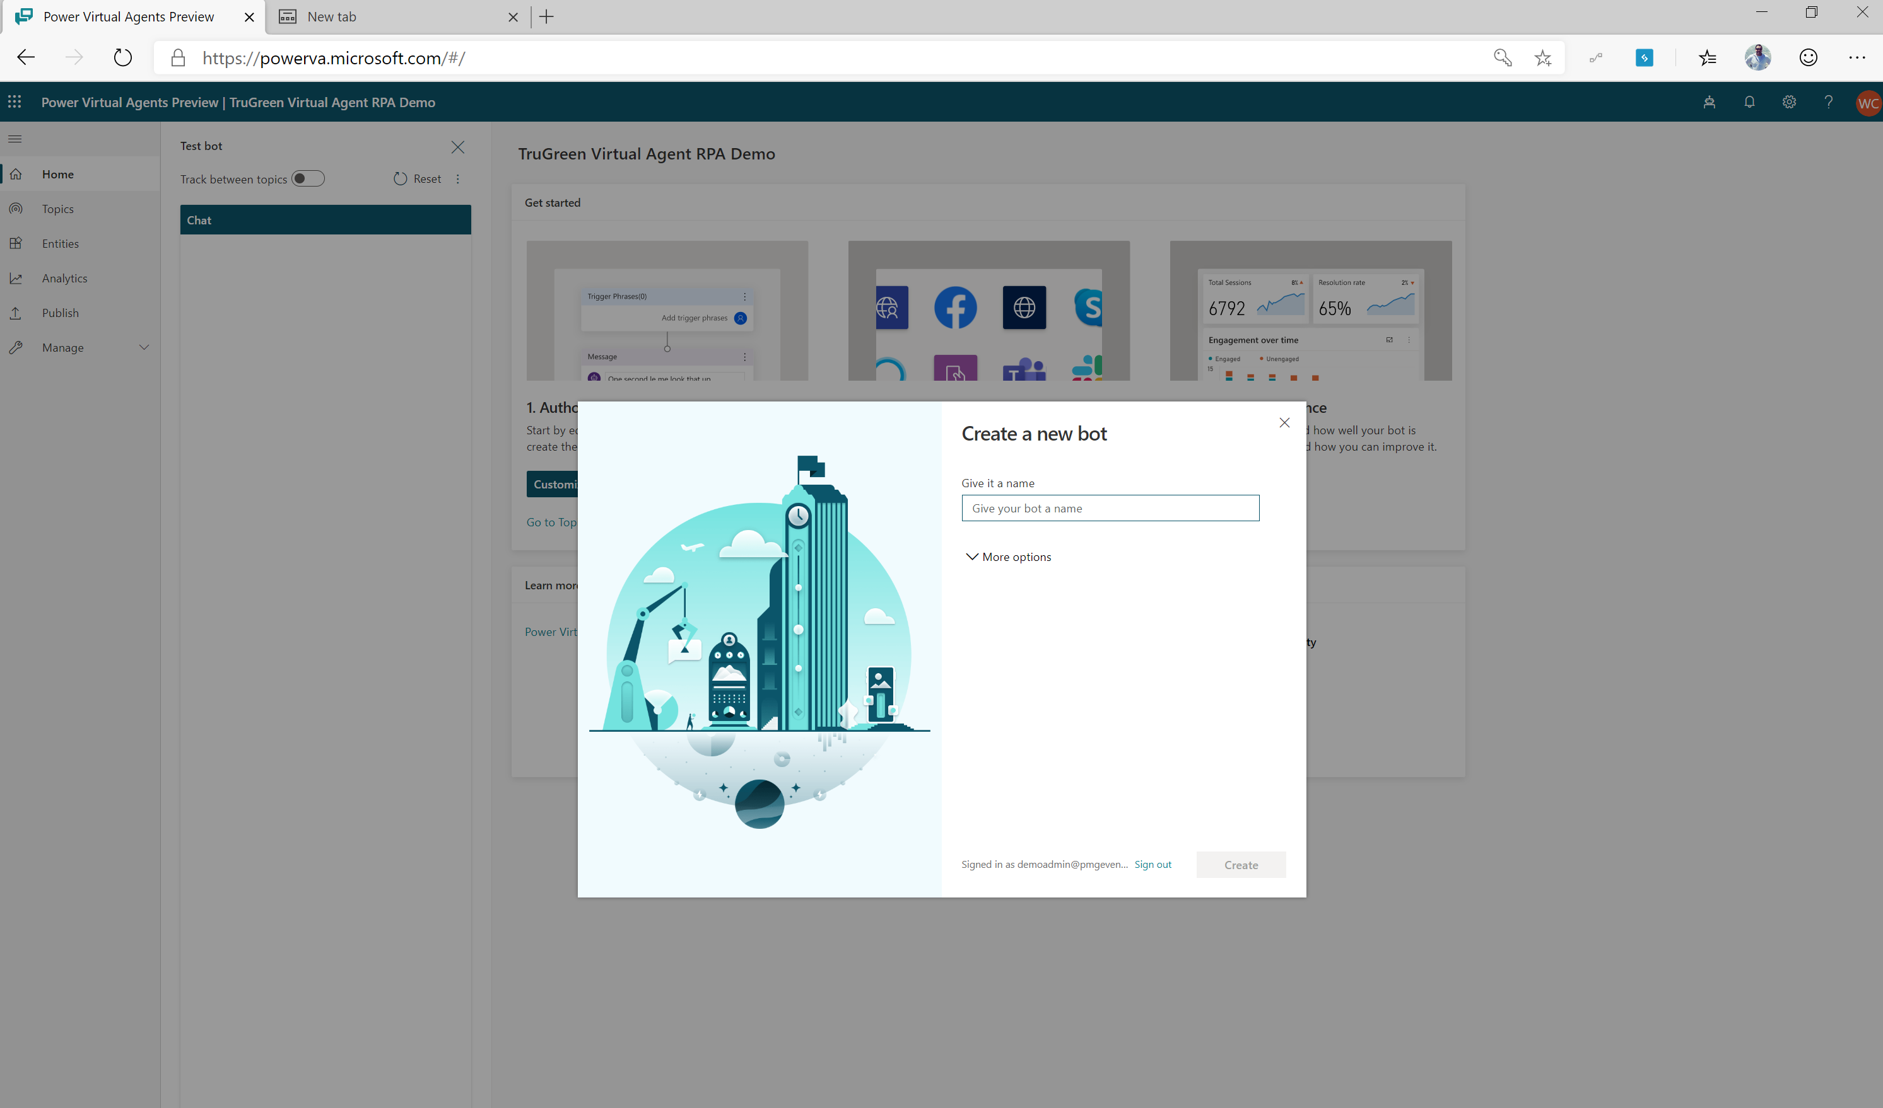
Create a New Virtual Agent
Open the Power Virtual Agents designer
https://powerva.microsoft.com/
Select ‘new bot’
Notes:
Power Virtual Agents makes creating a virtual agent very easy to do. Open the Power Virtual Agents designer and click on the ‘bot’ icon and then select ‘new bot’. Choose a name for your new virtual agent.

Slide 18
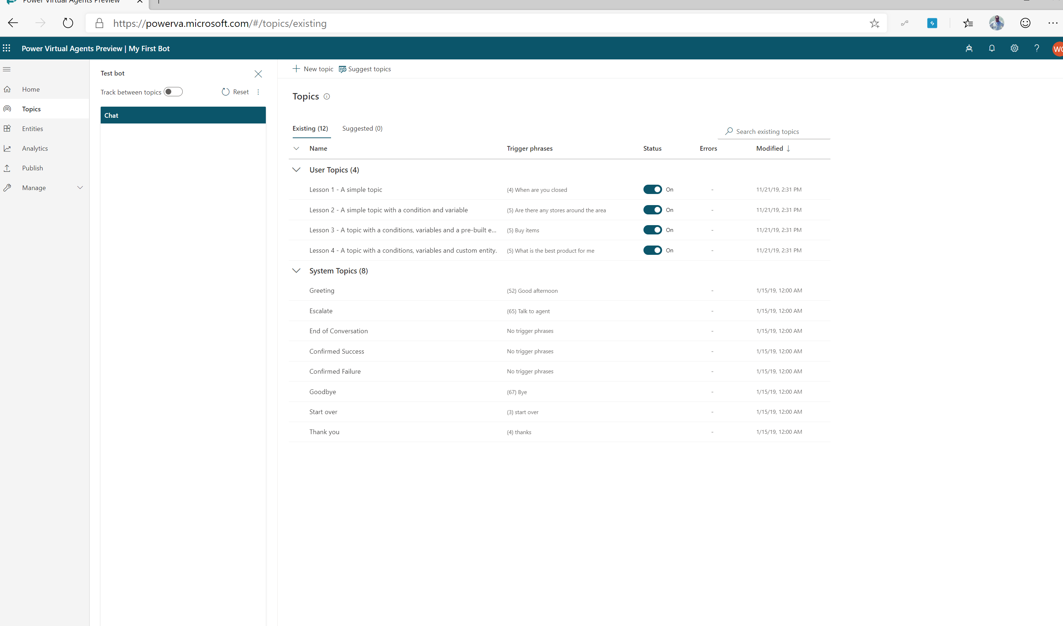
View Topics
A bot comes with 4 User topics & 8 system topics
Using one of the 4 topics to get familiar with the structure
Notes:
When you create your virtual agent, you need to decide what business scenarios you want your virtual agent address. You’ll create a topic for each scenario/question you want the bot to address.

Slide 19
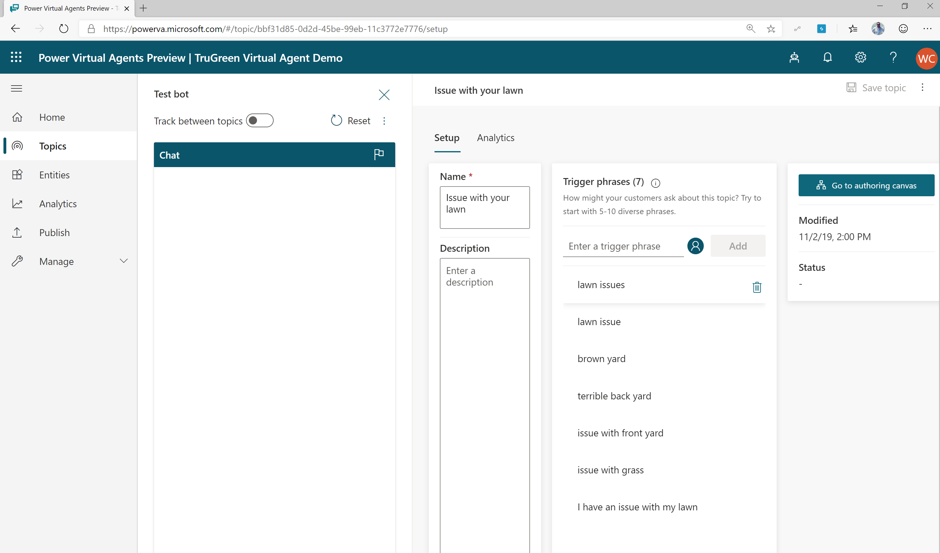
Add Conversational trigger phrases
For a topic you’ll define a few trigger phrases
A trigger phrase is a way to describe an intent, it captures the way a customer might ask about a problem/issue. E.g., “problem with weeds in lawn”
You only need to provide a few sample phrases – the AI will parse whatever the user says and trigger the topic closest in meaning to the user utterance
Notes:
Your virtual agent must have the appropriate trigger phrases relevant to your topic. In the example above, our topic is related to lawn concerns so we define trigger phrases which are relevant and likely for a lawn problem discussion.

Slide 20
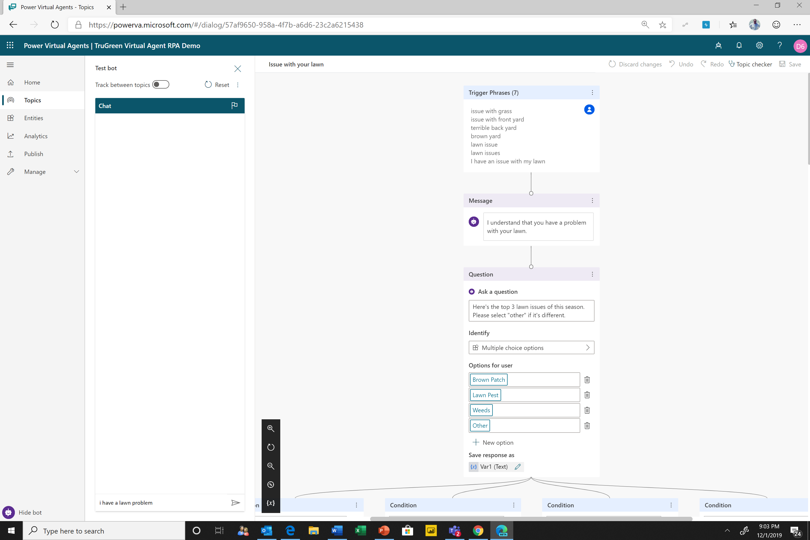
Open the authoring canvas and begin editing a topic
Open authoring canvas to view the conversation tree
You’ll see the trigger phrases at the top. You can edit the conversation tree, adding questions the bot should ask, things the bot should say etc.
Notes:
Open the authoring canvas and begin creating your virtual agent. The easy to use and understand dialogue tree enables any user to start creating a powerful virtual agent experience.

Slide 21
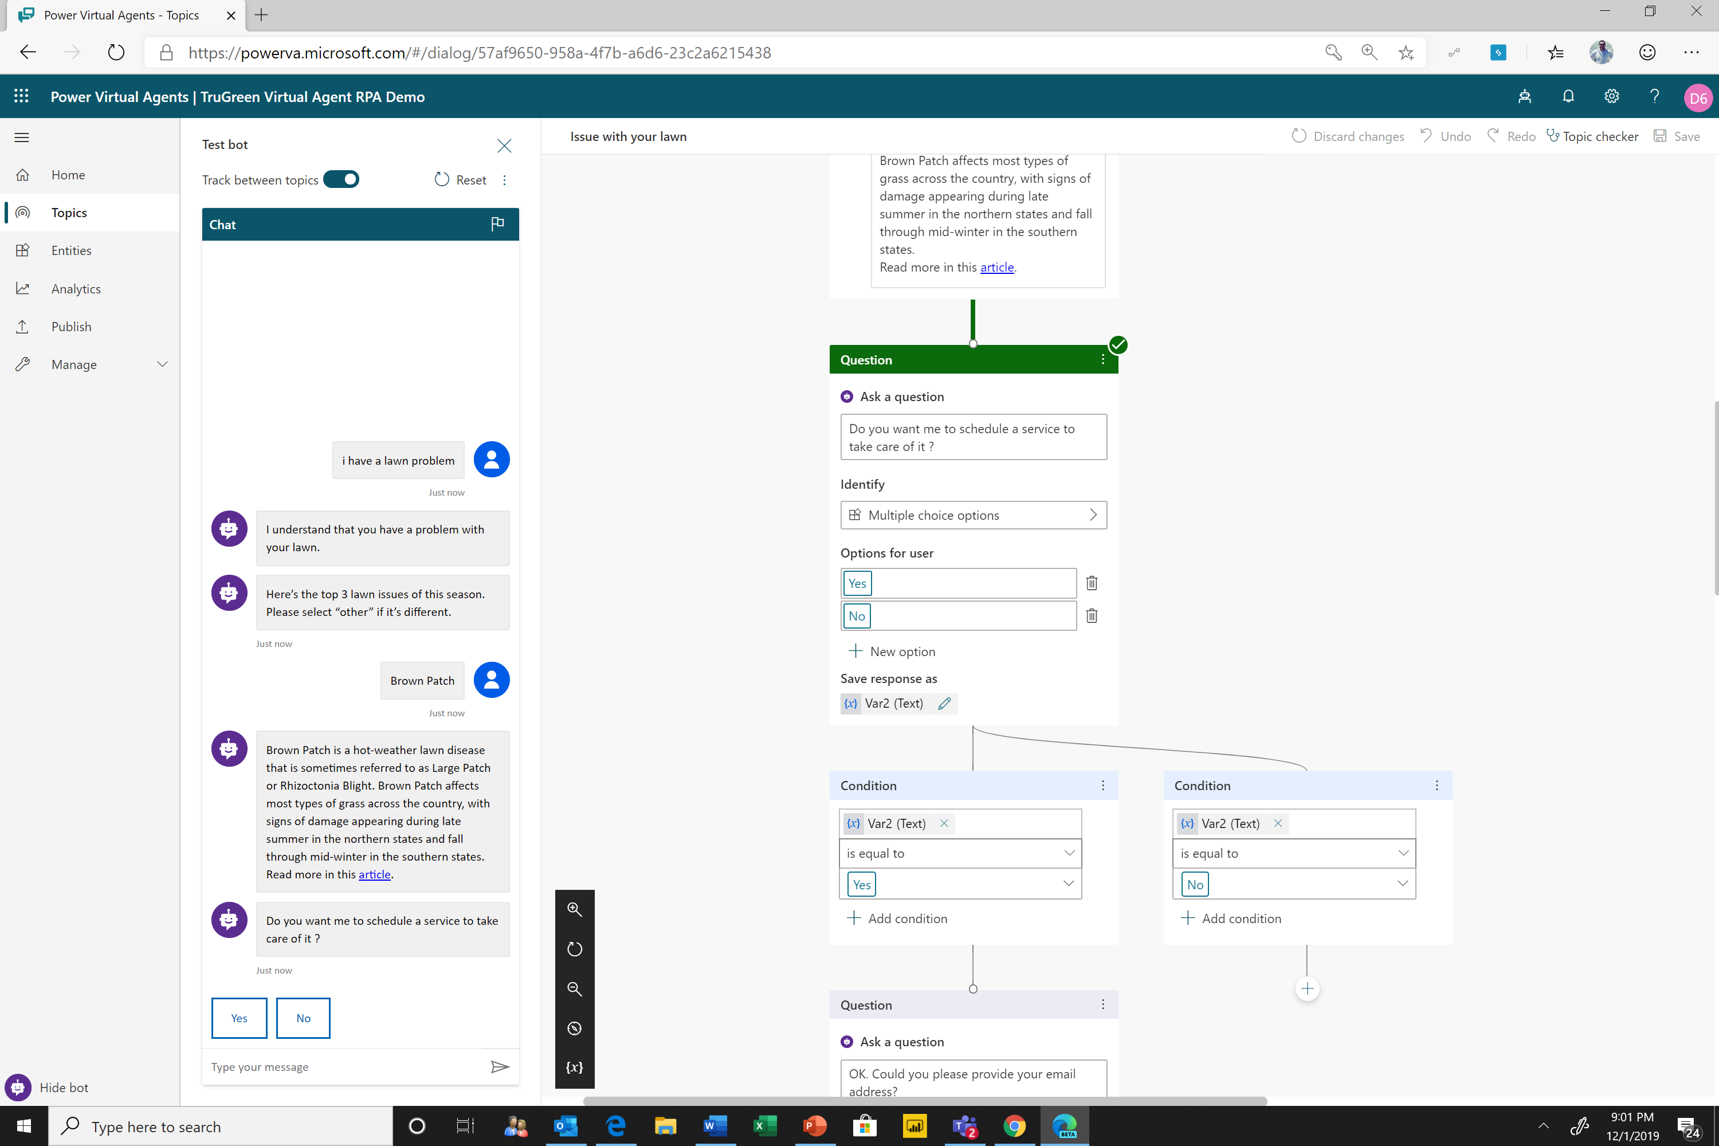
Test your topic as you construct it
To test what you’ve created click on test bot (bottom left) to expand test window
Turn on “Track between topics”. This lets you trace your way through both this topic and any others you call

Slide 22
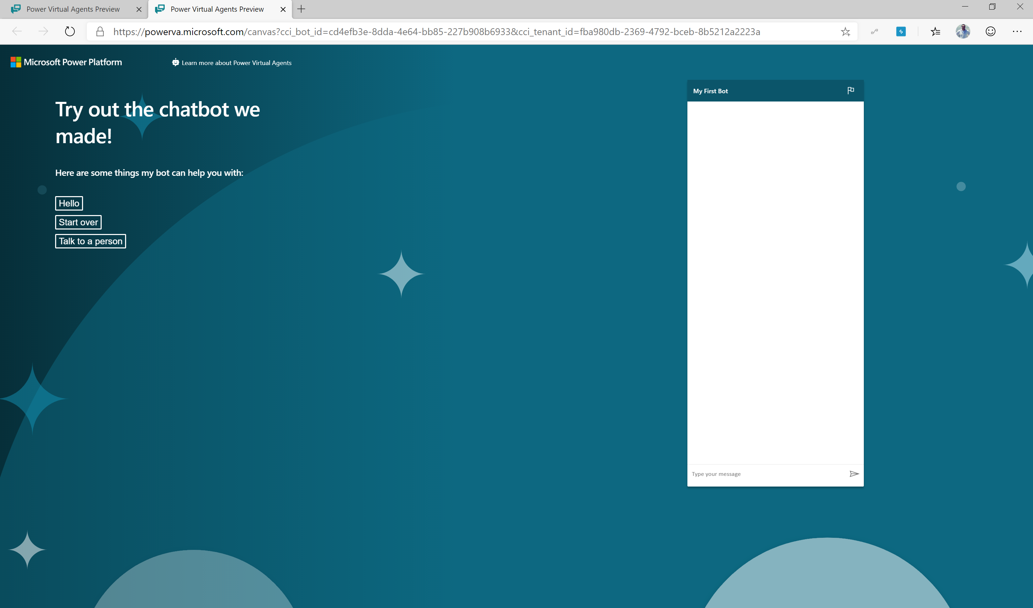
Publish to demo website
Publish to demo website and share the URL with colleagues so they can try the bot
Add screen shot with that publish to demo site show and demo page

Slide 23
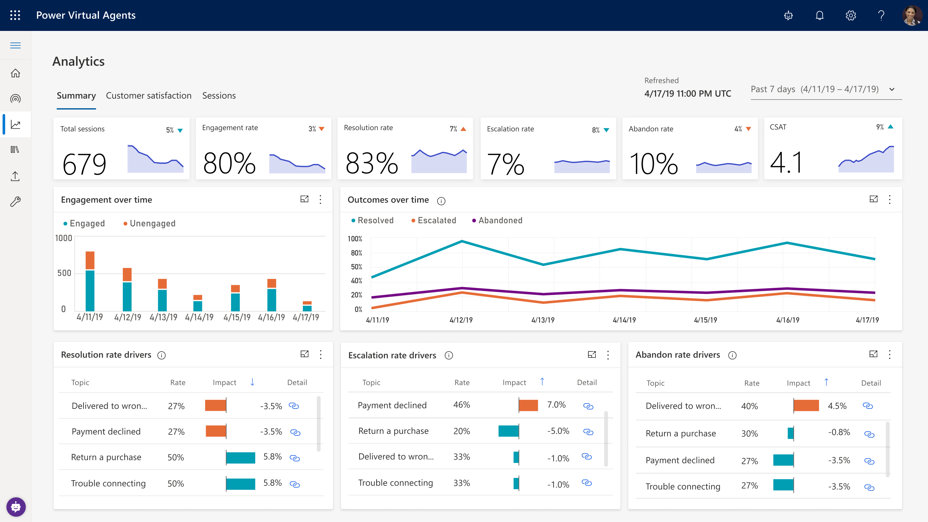
Enhance Your Virtual Agent From Analytics
GAIN VISIBILITY OF MANY PARAMETERS
Summary charts
Engagement over time chart
Session outcomes over time chart
Resolution rate drivers chart
Escalation rate drivers chart
Abandon rate drivers chart
Notes:
Easily see what’s working and what to improve
Analyze bot/customer conversations to better understand how specific topics are performing, what’s impacting your CSAT, and identify where there is room for improvement
Quickly figure out what to build next
Easily see which conversations are going to human agents and determine which topics to teach your bot next

Slide 24
SECTION SUMMARY
Power Virtual Agents enables users to create a chatbot in just minutes
Offers an easy to use designer to help create unique customer virtual agent experiences
Part of the Microsoft Power Platform
Built on the Microsoft Common Data Service

Slide 25
Lab 02: Build your first Virtual Agent

Slide 26
Create topics from existing webpages

Slide 27
Agenda
Module | ID | Name | Length
Overview & Setup | 1 | Introductions and pre-requisite | 60 minutes
Module 1 Power Virtual Agent | 2 | Build your first virtual agent | 45 minutes
 | 3 | Create topics from existing webpages | 30 minutes
 | 4 | Improve your virtual agent using entities, variables and topic redirects | 45 minutes
Module 2 Power Automate & other integrations | 5 | Integrate with prebuilt Power Automate flows | 45 minutes
 | 6 | Authentication – no lab | 20 minutes
 | 7 | Hand off to support agent– no lab | 20 minutes
Module 3 Optimization | 8 | Virtual agent topic design | 45 minutes
 | 9 | Best practices for writing topic trigger phrases | 20 minutes
 | 10 | Virtual agent conversation style | 20 minutes
 | 11 | Analytics, monitoring and VA performance improvement | 20 minutes
 | 12 | Closing | 10 minutes

Slide 28
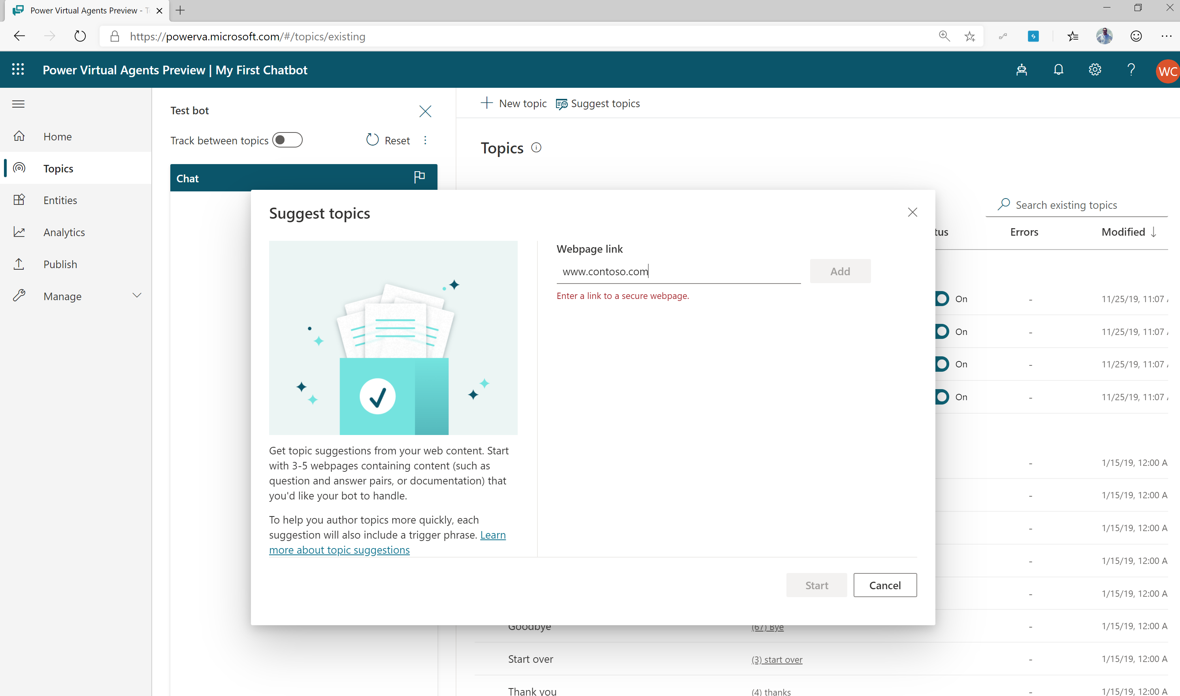
Let Microsoft AI Offer you Suggested FAQ Chatbot Topics
Each FAQ becomes a chatbot trigger
The answer to your FAQ becomes message text in dialogue tree
Create a single turn conversation tree in minutes
Notes:
Power Virtual Agents also offers suggested topics for your agent by leveraging Microsoft’s industry leading AI. Let Microsoft AI determine powerful potential topics which are crafted from our organization’s own web content. Elevate your customer’s awareness to topics and subjects that matter most.

Slide 29
Lab 03: Create topics from existing webpages

Slide 30
Enhance Virtual Agent using variables, topic redirections and entities

Slide 31
Agenda
Module | ID | Name | Length
Overview & Setup | 1 | Introductions and pre-requisite | 60 minutes
Module 1 Power Virtual Agent | 2 | Build your first virtual agent | 45 minutes
 | 3 | Create topics from existing webpages | 30 minutes
 | 4 | Improve your virtual agent using entities, variables and topic redirects | 45 minutes
Module 2 Power Automate & other integrations | 5 | Integrate with prebuilt Power Automate flows | 45 minutes
 | 6 | Authentication – no lab | 20 minutes
 | 7 | Hand off to support agent– no lab | 20 minutes
Module 3 Optimization | 8 | Virtual agent topic design | 45 minutes
 | 9 | Best practices for writing topic trigger phrases | 20 minutes
 | 10 | Virtual agent conversation style | 20 minutes
 | 11 | Analytics, monitoring and VA performance improvement | 20 minutes
 | 12 | Closing | 10 minutes

Slide 32
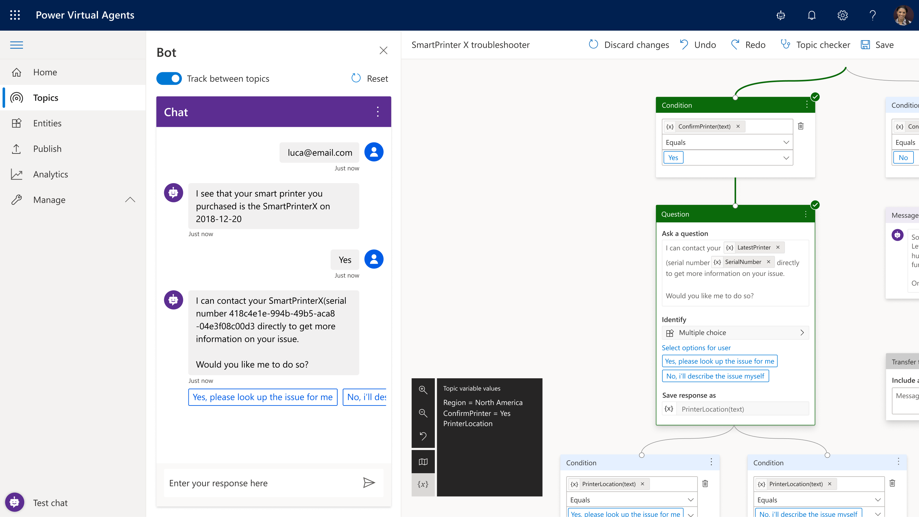
Easily create an Intelligent Virtual Agent
Simple, graphical bot creation
Easily test and maintain bots through a simple, easy to use graphical interface
Extract information from user responses
Recognize, extract, and act on dozens of common entities in a user’s responses. For example, colors, currencies, ages, dates and times. Or create your own custom entities, e.g. model numbers
Remember user responses
Store user information for use later in variables and use them to branch or create complex conversations

Slide 33
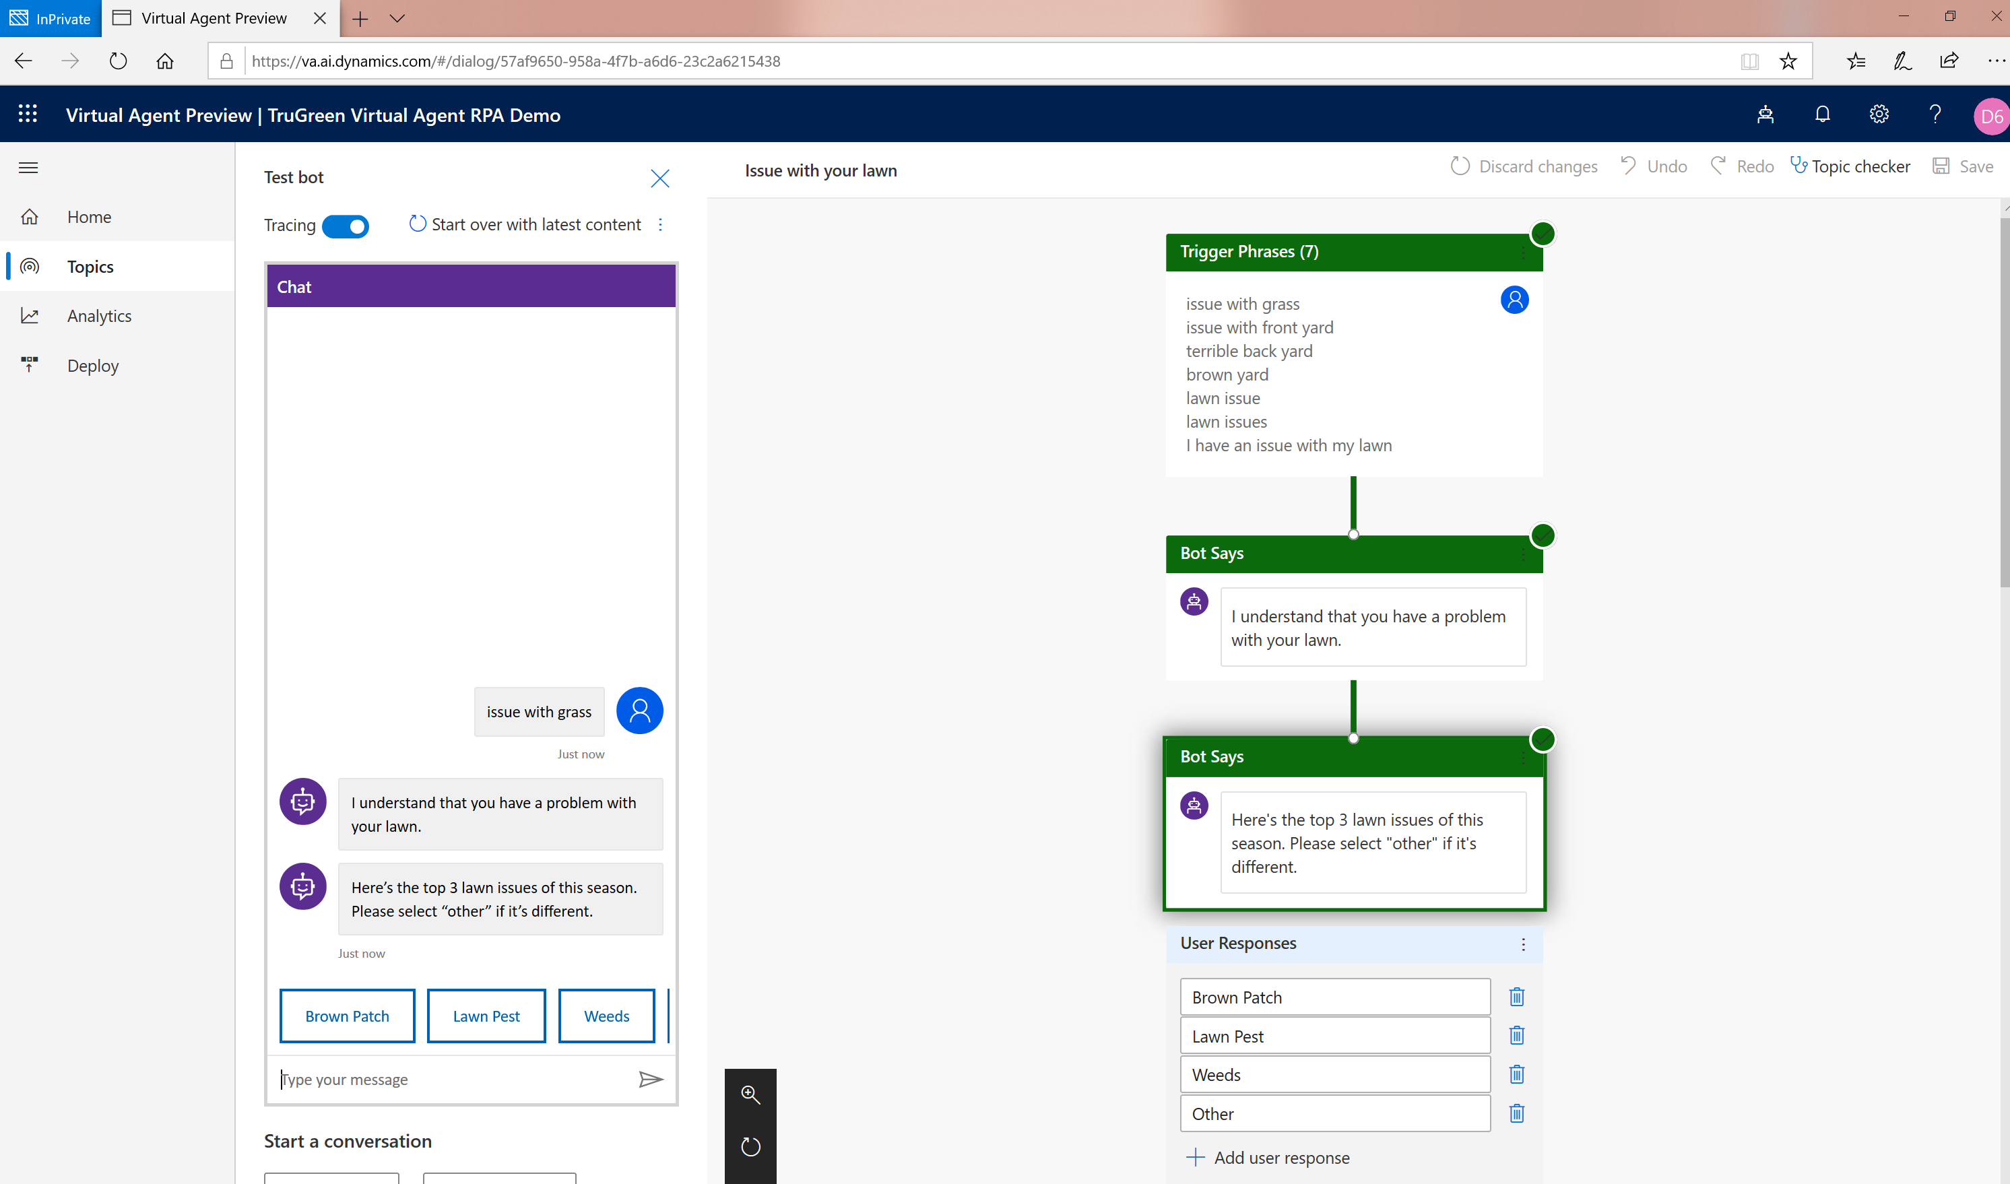
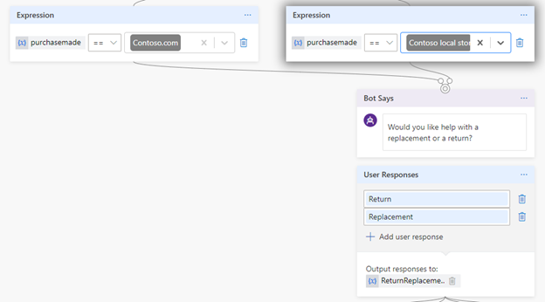
Use variables to navigate customers to tailored content
Direct your customers to content you want them to see
Power Virtual Agents
Add variables to keep customer information for later in the conversation

Slide 34
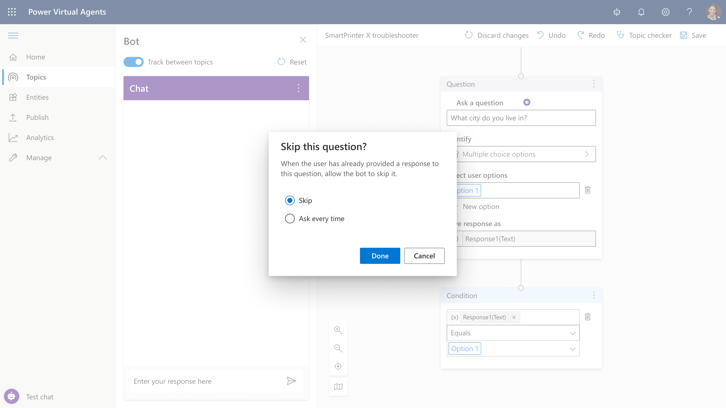
Slot-filling capabilities
Power Virtual Agents can intelligently avoid repetitive conversations
Enhances your efficiency as a maker
Power Virtual Agents can guide you to making the best experience

Slide 35
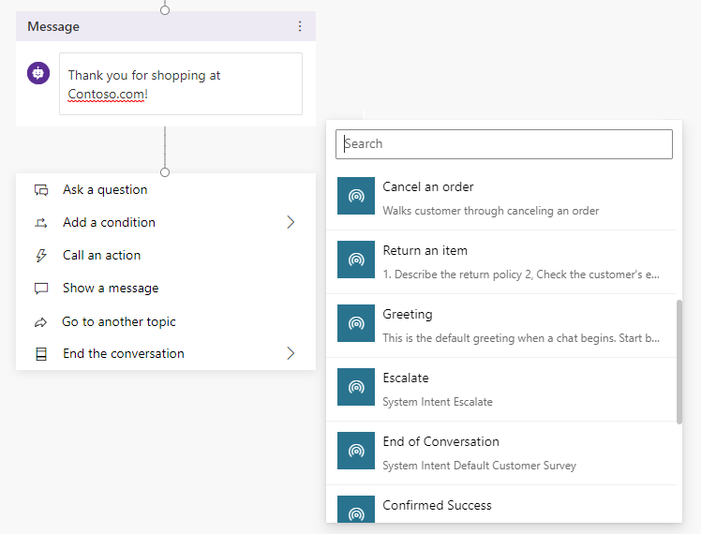
Easily re-direct users to related topics
Re-direct and connect customers to related topics
Power Virtual Agents
Use it when:
A conversation requires more than one topic, such as when you need to ask a clarifying question to determine which topic the user needs

Slide 36
Lab 04: Use variables, topic redirections and entities

Slide 37
Power Virtual Agents + Power Automate

Slide 38
Agenda
Module | ID | Name | Length
Overview & Setup | 1 | Introductions and pre-requisite | 60 minutes
Module 1 Power Virtual Agent | 2 | Build your first virtual agent | 45 minutes
 | 3 | Create topics from existing webpages | 30 minutes
 | 4 | Improve your virtual agent using entities, variables and topic redirects | 45 minutes
Module 2 Power Automate & other integrations | 5 | Integrate with prebuilt Power Automate flows | 45 minutes
 | 6 | Authentication – no lab | 20 minutes
 | 7 | Hand off to support agent– no lab | 20 minutes
Module 3 Optimization | 8 | Virtual agent topic design | 45 minutes
 | 9 | Best practices for writing topic trigger phrases | 20 minutes
 | 10 | Virtual agent conversation style | 20 minutes
 | 11 | Analytics, monitoring and VA performance improvement | 20 minutes
 | 12 | Closing | 10 minutes

Slide 39
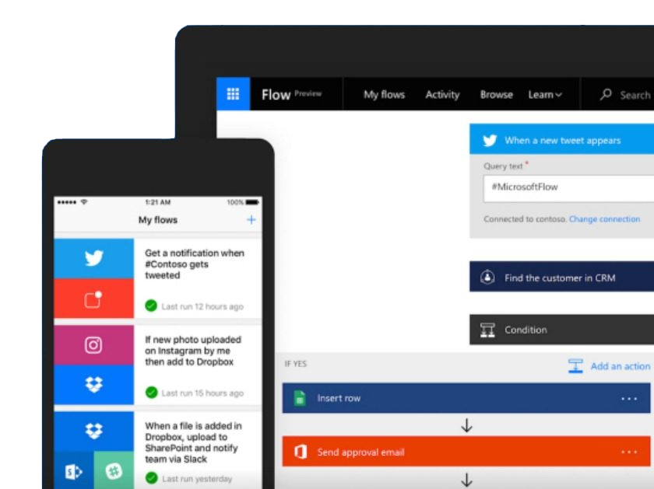
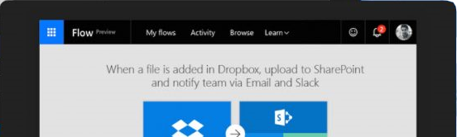
Power Automate is an online workflow service that automates actions across apps and services
© Microsoft Corporation Power Virtual Agents

Slide 40
A service for automating workflows across apps and services
Connect
to data & systems you’re already using, and create the data you need
Create
workflows using triggers & actions without code or scripts
Edit
flows on web and mobile
Approve
requests or manage them on web and mobile
© Microsoft Corporation Power Virtual Agents

Slide 41

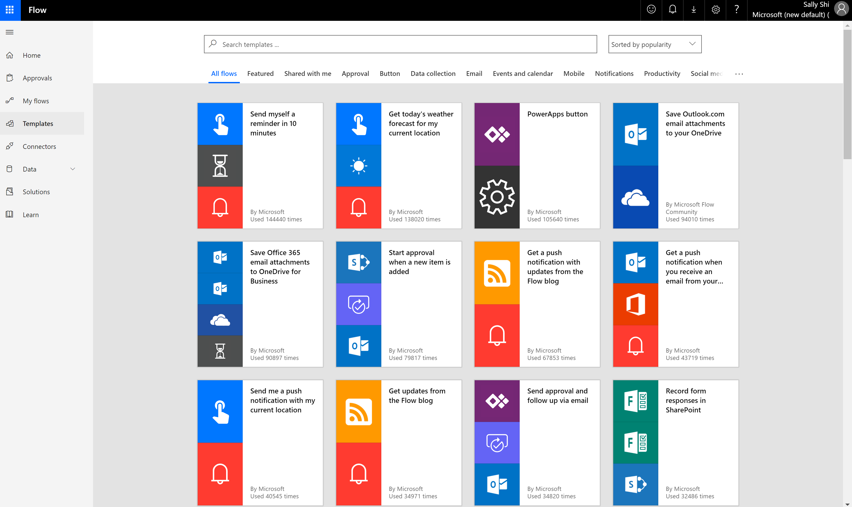
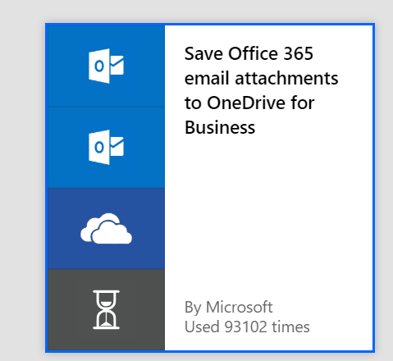
Get started with a growing library of templates
Jumpstart flows using over 100+ templates for common scenarios
Connect services you're already using in more meaningful ways

Slide 42
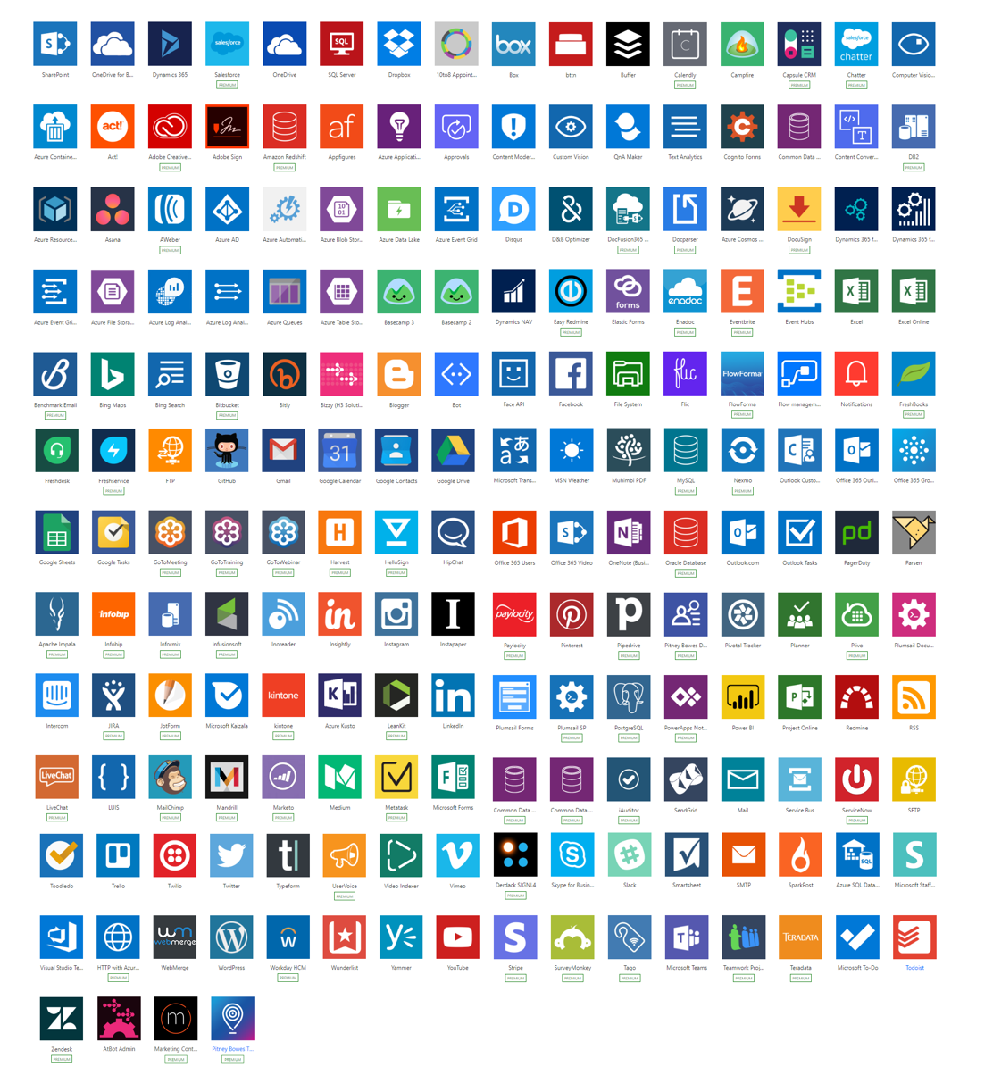
Connectivity & integration
Built-in connectivity to:
200+ SaaS cloud services
File providers
Databases
Web APIs
Productivity apps, etc.
Connect to on-premises systems via Data Gateway
Pluggable extensibility via Custom Connectors to integrate existing LOB systems into Power Automate

Slide 43


Efficient and secure data integration and storage
Power Automate is built on the Microsoft Common Data Service (CDS)
The Common Data Service lets you securely store and manage data that's used by business applications.
Dynamics 365
Office 365
Mobile Apps
Web Apps
Power Apps
Power Automate
Power BI
Power Virtual Agents
Common Data Service
Data connectors
Azure
Notes:
Power Automate is powered by the Microsoft Common Data Service. The Common Data Service lets you securely store and manage data that's used by business applications. Data within Common Data Service is stored within a set of entities. An entity is a set of records used to store data, similar to how a table stores data within a database. Common Data Service includes a base set of standard entities that cover typical scenarios, but you can also create custom entities specific to your organization and populate them with data using Power Query.
As you can see, the Common Data Service is a foundational element of the Power Platform which includes Power Automate.

Slide 44
Unlock your imagination with Power Automate + PVA
VA uses location-based services (LBS) to provide personalized services
2-factor authentications to increase security
Proactively recommends new promotions, benefits, and better rates to your customers
Check user eligibility and submit applications on their behalf
Remote diagnosis for IOT devices
Make appointments for your customers
Get a picture of the receipt from employee and use Azure AI for expense reimbursement (integration with Azure AI)

Slide 45
Lab 05: Add a Power Automate flow
Notes:
Focus on 2.1

Slide 46
Virtual Agent Authentication

Slide 47
Agenda
Module | ID | Name | Length
Overview & Setup | 1 | Introductions and pre-requisite | 60 minutes
Module 1 Power Virtual Agent | 2 | Build your first virtual agent | 45 minutes
 | 3 | Create topics from existing webpages | 30 minutes
 | 4 | Improve your virtual agent using entities, variables and topic redirects | 45 minutes
Module 2 Power Automate & other integrations | 5 | Integrate with prebuilt Power Automate flows | 45 minutes
 | 6 | Authentication – no lab | 20 minutes
 | 7 | Hand off to support agent– no lab | 20 minutes
Module 3 Optimization | 8 | Virtual agent topic design | 45 minutes
 | 9 | Best practices for writing topic trigger phrases | 20 minutes
 | 10 | Virtual agent conversation style | 20 minutes
 | 11 | Analytics, monitoring and VA performance improvement | 20 minutes
 | 12 | Closing | 10 minutes

Slide 48
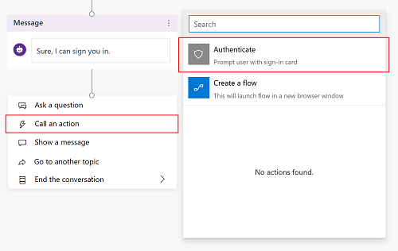
Easily add end-user authentication to your virtual agent
Add right from dialogue tree
Call an action
Choose Authenticate
Notes:
You can enable user authentication directly within a Power Virtual Agents bot conversation. This means you can prompt a user to sign in using single sign-on, retrieve a user token for that user, and then use that token to retrieve the user's information from a back-end system.

Slide 49
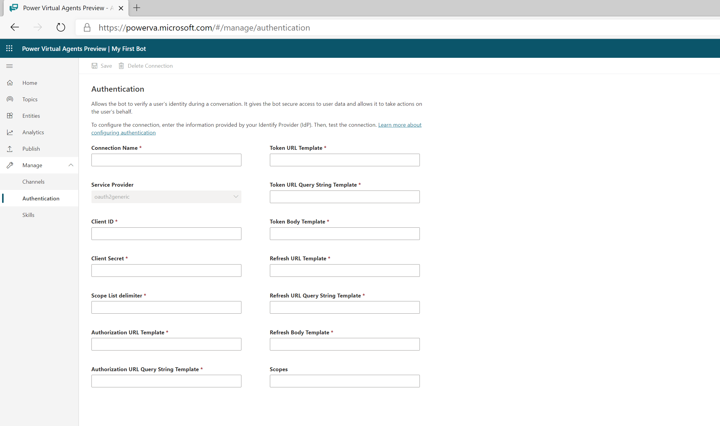
Configure end-user authentication
Add configuration capabilities to your virtual agent
Leverage Azure Active Directory
Adheres to OAuth2 standard
Notes:
You can configure a Power Virtual Agents bot to provide authentication capabilities, so users can sign in with any OAuth2 identity provider, such as Azure Active Directory (Azure AD), a Microsoft account, and Facebook.
Power Virtual Agents supports any identity provider that is compliant with the OAuth2 standard.

Slide 50
Hand off to support agent– no l Hand off to support agent

Slide 51
Agenda
Module | ID | Name | Length
Overview & Setup | 1 | Introductions and pre-requisite | 60 minutes
Module 1 Power Virtual Agent | 2 | Build your first virtual agent | 45 minutes
 | 3 | Create topics from existing webpages | 30 minutes
 | 4 | Improve your virtual agent using entities, variables and topic redirects | 45 minutes
Module 2 Power Automate & other integrations | 5 | Integrate with prebuilt Power Automate flows | 45 minutes
 | 6 | Authentication – no lab | 20 minutes
 | 7 | Hand off to support agent– no lab | 20 minutes
Module 3 Optimization | 8 | Virtual agent topic design | 45 minutes
 | 9 | Best practices for writing topic trigger phrases | 20 minutes
 | 10 | Virtual agent conversation style | 20 minutes
 | 11 | Analytics, monitoring and VA performance improvement | 20 minutes
 | 12 | Closing | 10 minutes

Slide 52
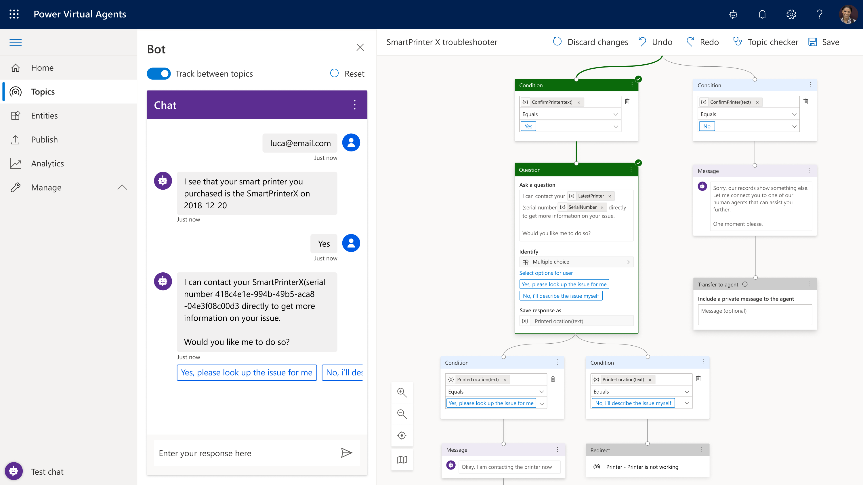
Virtual Agents and Human Agents Enhance Each Other
Power Virtual Agents easily partners with your human agents
Leverage the best of both
Create the ultimate experiences for your customers
Notes:
Overview: When a bot can’t handle the user’s requests or the user asks to talk to an agent at any point in the conversation, it’s important to gracefully bring in a human. In Power Virtual Agents, we are providing managers with the ability to configure and connect to multiple live chat engagement hubs.

Slide 53
Configure and connect a bot to a human
Hand-off to Dynamics 365 Omnichannel for Customer Service
IT admins can configure hand-off to live chat using Dynamics 365 Omnichannel for Customer Service
Hand-off to generic live-chat provider
IT admins can configure hand-off to live chat using an interface and sample code
Notes:
Hand-off to generic live-chat provider: IT admins can configure a hand-off from Virtual Agent to other live chat engagement hubs using an interface and sample code.

Slide 54



Dynamics 365 Omnichannel for Customer Service
Productivity
Multisession, Unified, Contextually rich experience for agents & Supervisors with enhanced service management capabilities for routing, work distribution and new productivity tools.
Customer
Agent,
Supervisors
Channels
Intelligence
Provide personalized service to customers from a channel of their choice – Chat, SMS. Plugin a bot to handle routine requests and free your agents to work on complex issues
Determine customer satisfaction automatically in real time with Sentiment Analysis. Get actionable insights from Interaction trends across channels, Agent performance & utilization data
Convenient
Productive
Insightful
Notes:
Hand-off to Dynamics 365 Omnichannel for Customer Service
Out of the box, PVA comes configured to work with Dynamics 365 Omnichannel for Customer Service. When the bot can’t help, it pulls in a human agent automatically.

Slide 55
Virtual agent topic design

Slide 56
Agenda
Module | ID | Name | Length
Overview & Setup | 1 | Introductions and pre-requisite | 60 minutes
Module 1 Power Virtual Agent | 2 | Build your first virtual agent | 45 minutes
 | 3 | Create topics from existing webpages | 30 minutes
 | 4 | Improve your virtual agent using entities, variables and topic redirects | 45 minutes
Module 2 Power Automate & other integrations | 5 | Integrate with prebuilt Power Automate flows | 45 minutes
 | 6 | Authentication – no lab | 20 minutes
 | 7 | Hand off to support agent– no lab | 20 minutes
Module 3 Optimization | 8 | Virtual agent topic design | 45 minutes
 | 9 | Best practices for writing topic trigger phrases | 20 minutes
 | 10 | Virtual agent conversation style | 20 minutes
 | 11 | Analytics, monitoring and VA performance improvement | 20 minutes
 | 12 | Closing | 10 minutes

Slide 57
What makes a virtual agent successful?
Knowing your customer
Having accurate, latest and effective content
Knowing when to hand off to a human
Understanding the customer’s request and connecting it to the right topic
Providing personalized, context-aware help, and taking actions for the customer
© Microsoft Corporation Power Virtual Agents

Slide 58
Types of conversation topics
People use your bot with a specific issue (“topic”) to address or resolve. You can loosely categorize topics into 3 types:
Informational
What is…? When will…? Why…?
Task completion
I want to… How do I…?
Troubleshooting
Something isn’t working right. I got an error message.
Notes:
You may also need some topics that are just there to take ambiguous user questions (“I need help” or “shopping”) and ask for clarification so you can then route the user to the correct topic.

Slide 59
Designing a topic
Identify the topic
List all scenarios
Design a high-level conversation tree
Design solutions
Validate and iterate on the design
Choose a topic your bot audience will ask about
Focus on high-impact topics first
Put your customer empathy hat on … topic design requires understanding both sides of the conversation
List all possible scenarios
Think about informational needs, task completion, and troubleshooting
Use your favorite tool to draw the conversation tree
What is the fewest number of questions you can ask to understand the situation enough to provide the right solution?
Integrate with Power Automate to personalize and speed issue identification
Make answers clear and concise so users can scan information quickly
Integrate with Power Automate to take action on the user’s behalf
Read the dialog out loud before publishing
Get analytics and read session transcripts for further optimization

Slide 60
Lab 08: Virtual agent topic design

Slide 61
Best practices for writing topic trigger phrases

Slide 62
Agenda
Module | ID | Name | Length
Overview & Setup | 1 | Introductions and pre-requisite | 60 minutes
Module 1 Power Virtual Agent | 2 | Build your first virtual agent | 45 minutes
 | 3 | Create topics from existing webpages | 30 minutes
 | 4 | Improve your virtual agent using entities, variables and topic redirects | 45 minutes
Module 2 Power Automate & other integrations | 5 | Integrate with prebuilt Power Automate flows | 45 minutes
 | 6 | Authentication – no lab | 20 minutes
 | 7 | Hand off to support agent– no lab | 20 minutes
Module 3 Optimization | 8 | Virtual agent topic design | 45 minutes
 | 9 | Best practices for writing topic trigger phrases | 20 minutes
 | 10 | Virtual agent conversation style | 20 minutes
 | 11 | Analytics, monitoring and VA performance improvement | 20 minutes
 | 12 | Closing | 10 minutes

Slide 63
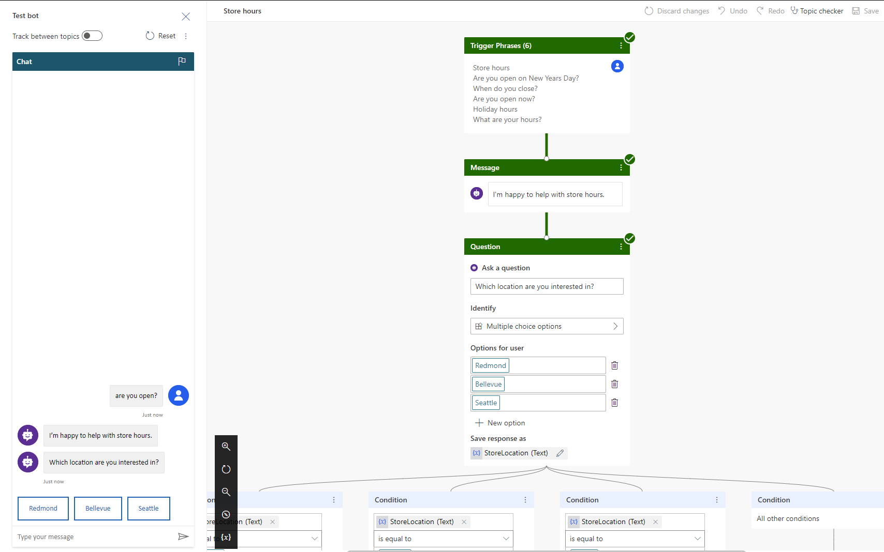
Trigger phrases – Definition
Trigger the virtual agent to begin a conversation about a specific topic

Slide 64





Guidelines for better trigger phrase design
Clearly understand the goal and scope of the topic
Start with 5 to 10 trigger phrases
Shorter trigger phrases with fewer than 10 words are generally better
Make sure the trigger phrases are semantically different
Use the words your customers use!
Avoid trigger phrases that are highly ambiguous among different topics

Slide 65
Step 1: Pick a topic
Find Products
Special Products – Gift Cards
Browse Products
Refund
Shipment
Fees
Timeframe
“Return an Item”
Return/ Exchange
Pricing
Find a Promotion
Price Match
Member Benefits
Checkout
Delivery
Tax
Tax Calculation
Post-sale
Price Adjustment
Price Adjustment
Payment
Payment Methods
Address
Coupon
Shipment
Order Cancellation
Change/ Cancel Order
Address Validation
Shipping Address
Billing Address
Fraud Check
Order Confirmation
Back Order/Cancellation
Warranty
Order Status

Slide 66
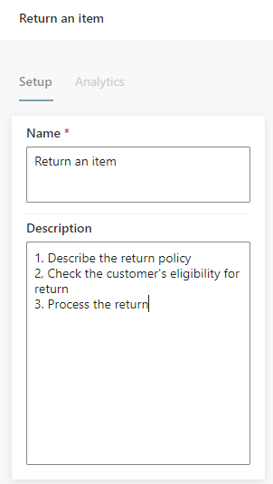
Step 2: Define the goal for the topic
Topic: "Return an item"
Goal:
1. Describe return policy of the store
2. Check customer’s eligibility for return
3. Process the return

Slide 67
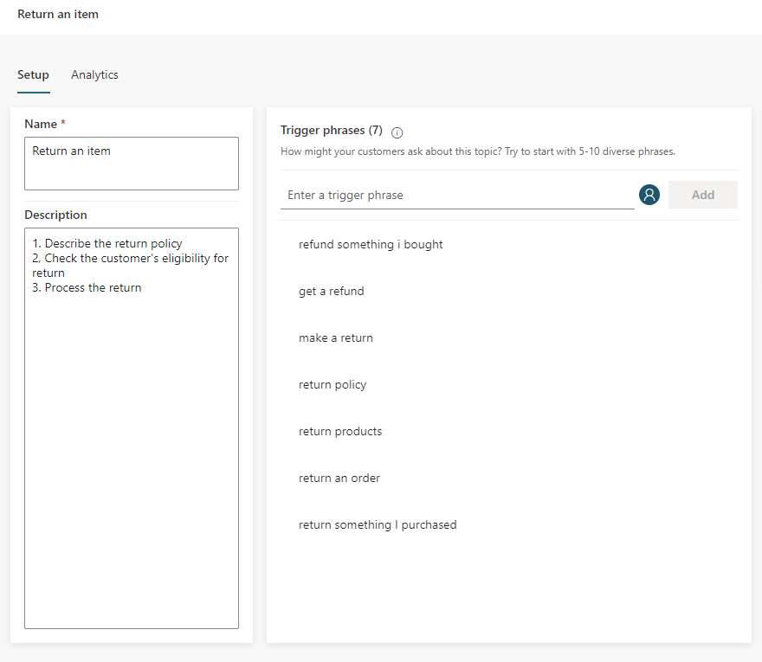
Step 3: Create trigger phrases
Steps:
Start with 5 to 10 trigger phrases. You may need more trigger phrases if the scope of the topic is large
Shorter trigger phrases with less than 10 words are generally better

Slide 68
Step 4: Review trigger phrases
Steps:
Make sure the trigger phrases are semantically different; using one different noun or verb could be enough to expand a topic’s coverage

Slide 69
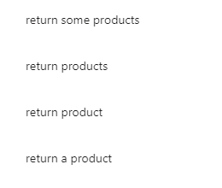
Adding articles (an, the, etc.), capitalization, contractions, and pluralization has a low chance of improving the triggering

Slide 70
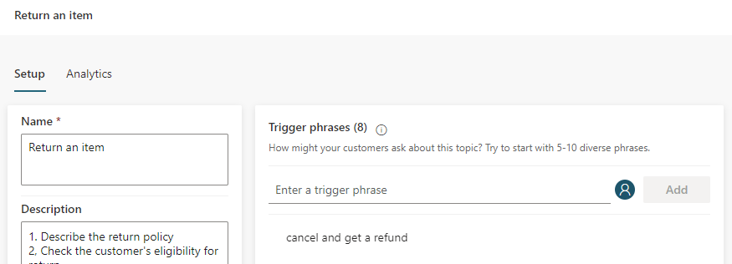
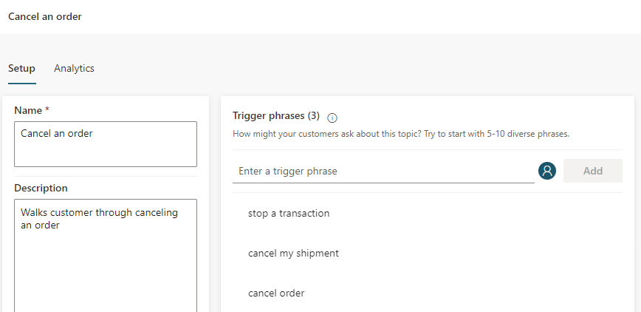
Avoid overlapping trigger phrases or ambiguous trigger phrases among different topics

Slide 71
Quiz time…

Slide 72
Q1: For the topic “Return an item,” please select the best trigger phrase from below:
A. I want to return an item.
B. My mom was cooking last night when I came back home from school, and suddenly the refrigerator stopped working. Can I return it?
C. I don't like any of the items I purchased from your store.

Slide 73
Answer: A
A is the best because it's direct and simple
A. I want to return an item.
B is not good because it is too complicated. It introduces too many irrelevant keywords which could potentially connect to the wrong topics
B. My mom was cooking last night when I came back home from school, and suddenly the refrigerator stopped working. Can I return it?
C depends on your business logic. If you want to cover this scenario in this topic, then you should add it to the trigger phrases
C. I don't like any of the items I purchased from your store.

Slide 74
Q2: For the topic “Return an item,” please select the good trigger phrases from below:
A. What is your return policy?
B. I want to return my refrigerator.
C. How can I make a return?
D. I want to return an item.

Slide 75
Answer: A, B, C, D
A. What is your return policy?
A is good because it is simple and direct. However, you need to make sure your topic covers “return policy”
B. I want to return my refrigerator.
B is good because it is simple and direct. However, you need to make sure your topic covers “refrigerator”
C. How can I make a return?
C is good because it covers another way to request a return -- use "return" as a noun
D. I want to return an item.
D is good especially when your store has many items and you cannot list them all

Slide 76
Q3: For the topic “Return an item,” here is a sentence from real customer chatlogs.
Write some trigger phrases for it:
“I am a member of your store for over 5 years. I was wondering how to return items that I got yesterday. I don’t like the color.”

Slide 77
Answer:
Step 1: Remove all irrelevant parts, and keep words relevant to the goals of the topic
“I am a member of your store for over 5 years. I was wondering how to return items that I got yesterday. I don’t like the color.”
Step 2: Add new trigger phrases with different keywords
After that, we can produce 5 good trigger phrases:
1
How to return something that I purchased last week
2
How to return something that I bought yesterday
3
How to return products
4
How to return orders
5
How to return items that I got yesterday

Slide 78
Q4: For the “Return an item” topic, which trigger phrases below should you include as a start?
1. I want to return an item
2. I want to return items
3. I want to return two items
4. I would like to return some items
5. I’d like to return an item

Slide 79
Answer: Any ONE of those trigger phrases works
1. I want to return an item
2. I want to return items
Guideline
Adding articles (an, the, etc.), capitalization, contractions, and pluralization has low chance of improving the triggering.
3. I want to return two items
4. I would like to return some items
5. I’d like to return an item

Slide 80
Q5: For the topic “My appliance doesn’t work”, please select the best trigger phrase from below:
A. I want to buy another dishwasher.
B. My freezer doesn’t work.
C. I have a problem.
D. Something is wrong with my appliance.

Slide 81
Answer: D
A. I want to buy another dishwasher.
A is not good because it is not related to the topic at all
B. My freezer doesn’t work.
B depends on your business logic. If "freezer" is out of your business scope, you should not use it
C. I have a problem.
C is not good because it is too broad. You may want to use another generic topic to handle “I have a problem”
D. Something is wrong with my appliance.
D is the best because it is simple and direct

Slide 82
Q6: Below is a sentence from real customer chatlogs. Which topic should we add this trigger phrase to?
Sentence: "My new refrigerator stops working, so I want to return it"
A. Add it to the “Return item” topic.
B. Add it to the “My appliance doesn’t work” topic.
C. We shouldn’t add it to any of these two topics.
D. We should add it to both topics.

Slide 83
Answer: C
Sentence: "My new refrigerator stops working, so I want to return it"
A. Add it to the “Return item” topic.
B. Add it to the “My appliance doesn’t work” topic.
Answer: C
This is a bad trigger phrase because it's too ambiguous. To avoid confusion, do not add this sentence to either of the 2 topics
The AI model DYM (do you mean) will further clarify with customers and ask them to choose a topic
C. We shouldn’t add it to any of these two topics.
D. We should add it to both topics.

Slide 84
Virtual Agent conversation styles

Slide 85
Agenda
Module | ID | Name | Length
Overview & Setup | 1 | Introductions and pre-requisite | 60 minutes
Module 1 Power Virtual Agent | 2 | Build your first virtual agent | 45 minutes
 | 3 | Create topics from existing webpages | 20 minutes
 | 4 | Improve your virtual agent using entities, variables and topic redirects | 45 minutes
Module 2 Power Automate & other integrations | 5 | Integrate with prebuilt Power Automate flows | 30 minutes
 | 6 | Authentication – no lab | 30 minutes
 | 7 | Hand off to support agent– no lab | 20 minutes
Module 3 Optimization | 8 | Virtual agent topic design | 45 minutes
 | 9 | Best practices for writing topic trigger phrases | 20 minutes
 | 10 | Virtual agent conversation style | 20 minutes
 | 11 | Analytics, monitoring and VA performance improvement | 20 minutes
 | 12 | Closing | 10 minutes

Slide 86
Qualities of a good conversation
Cooperative
Goal-oriented
Fast
Turn-based
Truthful
Polite
Source: Erika Hall, Conversational Design

Slide 87
Style: How to sound conversational
Customer conversations should emulate the best elements of any conversation — personal and polite, friendly and supportive
A few stylistic changes in writing can impart warmth and familiarity to your brand voice
Don’t overuse exclamation points to convey energy. It’s easy to rely on them for this purpose, but too many, in the wrong places, could be interpreted as insincere and robotic
Hey Bryan! Would you like the usual — a large cheese pizza?
So you know, there is a buy-a-large-get-a-small-free deal going on through Saturday. Do you want to try this deal?
Yeah!!
Great! Let me get your order started for you.

Slide 88
Style: How to sound conversational
Sounds great! Let me get that started for you.
Let’s get started. I have a couple questions. Should only take a minute.
No problem. I can resolve this for you.
Use short sentences
Be positive
Use active voice

Slide 89
Style: How to sound conversational
I’m going to ask you a couple questions. It should only take a minute.
Good choice. I have a couple suggestions based on what you’ve selected.
Great.
Use contractions: “I’m” instead of “I am.”
Select a pronoun to represent your brand agent in chat and be consistent: “I” or “we.”

Slide 90
Style: How to sound conversational
Be consistent with tone and style so the conversation sounds like it’s with the same agent and brand
Do
Don’t
Hi there. Welcome to the Store Assistant. I can help you make a return or exchange.
Hi there. Welcome to the Store Assistant. I can help you make a return or exchange.
Let me know at any time if you’d like to chat with a live customer service agent.
If you wish to be in contact with a live customer service agent in regards to your problem, please click the button below.
I want to return an item
Tone shifts to formal
I want to return an item
OK. Could you provide your order number, please?
OK. Provide your order number.
Demanding tone

Slide 91
Style: How to sound conversational
If you’re using website documentation to answer a question, break sections down into short, scannable graphs
Do
Don’t
How to reset your password: 1. Go to https://account.live.com/password/reset. 2. Select the reason for resetting your password and the alternate contact info where you can receive a security code to verify your identity. Note: This alternate contact info is part of the security info you already added to your Microsoft account.
How to reset your Password If you cannot remember your password, go to https://acount.live.com/password/reset and select the reason for resetting your password. Then include the alternate contact info where you can receive a security code to verify your identity. Note: This alternate contact info is part of the security info you already added to your Microsoft account.

Slide 92
Style: How to sound conversational
Pace the conversation in short, scannable units
Break up messages into separate, readable blocks to make the pace of the conversation feel more natural
Make sure the agent doesn’t respond so quickly that it rushes the customer. Add a minimum delay if necessary
Check in to make sure the user is following the conversation after explaining or answering a question, particularly a complex one
Before we begin, what type of account do you have?
Student
OK, what type of device are you using?
Tablet
Great! First, we need to reset your credentials. I’ll walk you through how to do this.
Open Spotlight by selecting the magnifying glass at the top right of your setting.
Then search for and open CountrySetting.

Slide 93
Style: How to sound conversational
Maintain a friendly tone when helping to complete the task
Tailor the tone of the agent’s responses to the context. If it’s something serious—like billing or cybersecurity—be empathetic but brief and straightforward. If it’s a more mundane situation (like creating a new account), the tone can be more relaxed.
Exclamation points don’t express energy or excitement. Strong writing does, particularly strong verbs. In your desire to help, avoid sounding condescending or insincerely enthusiastic.
Don’t
Hi, I need help with my bill.
Oh! The first step is understanding how your service is billed.
Bills can be complex!
Do
I understand you need help with your bill. Can you tell me in a few words what the issue is?
Charges
Account Settings
Payment

Slide 94
Style: How to sound conversational
Invite the user into the conversation on a regular basis by asking questions or making suggestions.
Respond to the customer in a timely manner.
If the Virtual Agent may take a while to process the customer’s request, let the customer know what to expect.
Hey Bryan, just checking to see if you still need help with your bill?
Yes sorry
No problem. Do you have your account number, or do you need help finding it?
My account number is 1234567
Thanks! Please wait while I grab your billing info.

Slide 95
Style: How to sound conversational
Customers abandon a chat when the prompts are lengthy, so keep them brief. To keep your writing simple and straightforward, use the Flesch-Kincaid Grade Level feature in Microsoft Word or an app like Hemingwayapp.com to figure out the grade level for your scripts. In general, the lower the grade level, the better.
What will it be primarily used for?
School
OK. What type of activities will you be using it for?
Homework
Which of these features is most important to you?
Memory
Alright. Here are some options for you…

Slide 96
Lab 10: Style & the sound of conversation

Slide 97
Instructions
In this session, go through the writing tips and see how the example for each was revised using conversation design principles that you just learned

Slide 98
Tips
1
Write like you speak
Read your text aloud. Does it sound like something a real person would say? Be friendly and conversational. No. Robot. Words
Example | Revised
Invalid ID
You need an ID that looks like this: someone@example.com
Notes:
You need an ID that looks like this: someone@example.com

Slide 99
Tips
2
Use bigger words, fewer ideas
Our modern design hinges on crisp minimalism. Shorter is always better.
Example | Revised
If you're ready to purchase Office 365 for your organization, contact your Microsoft account representative
Ready to buy? Contact us
Notes:
Ready to buy? Contact us.

Slide 100
Tips
3
Be brief
Give customers just enough information to make decisions confidently. Prune every excess word.
Example | Revised
The Recommended Charts command on the Insert tab recommends charts that are likely to represent your data well. Use the command when you want to visually present data, and you're not sure how to do it
Create a chart that’s just right for your data by using the Recommend Charts command on the Insert tab
Notes:
Create a chart that's just right for your data by using the Recommend Charts command on the Insert tab.

Slide 101
Tips
4
Get to the point fast
Lead with what’s most important. Front-load keywords for scanning. Make customer choices and next steps obvious.
Example | Revised
Templates provide a starting point for creating new documents. A template can include the styles, formats, and page layouts you use frequently. Consider creating a template if you often use the same page layout and style for documents.
Save time by creating a document template that includes the styles, formats, and page layouts you use most often. Then use the template whenever you create a new document
Notes:
Save time by creating a document template that includes the styles, formats, and page layouts you use most often. Then use the template whenever you create a new document.

Slide 102
Tips
5
Project friendliness
Use contractions: It’s, you’ll, you’re, we’re, let’s. . .
Example | Revised
To help you avoid traffic, remember anniversaries, and in general do more, Cortana needs to know what you are interested in, what is on your calendar, and who you are doing things with
To help you avoid traffic, remember anniversaries, and in general do more, Cortana needs to know what you’re interested in, what’s on your calendar, and who you’re doing things with
Notes:
To help you avoid traffic, remember anniversaries, and in general do more, Cortana needs to know what you’re interested in, what’s on your calendar, and who you’re doing things with.

Slide 103
Analytics, monitoring and VA performance improvements

Slide 104
Agenda
Module | ID | Name | Length
Overview & Setup | 1 | Introductions and pre-requisite | 60 minutes
Module 1 Power Virtual Agent | 2 | Build your first virtual agent | 45 minutes
 | 3 | Create topics from existing webpages | 20 minutes
 | 4 | Improve your virtual agent using entities, variables and topic redirects | 45 minutes
Module 2 Power Automate & other integrations | 5 | Integrate with prebuilt Power Automate flows | 30 minutes
 | 6 | Authentication – no lab | 30 minutes
 | 7 | Hand off to support agent– no lab | 20 minutes
Module 3 Optimization | 8 | Virtual agent topic design | 45 minutes
 | 9 | Best practices for writing topic trigger phrases | 20 minutes
 | 10 | Virtual agent conversation style | 20 minutes
 | 11 | Analytics, monitoring and VA performance improvement | 20 minutes
 | 12 | Closing | 10 minutes

Slide 105
Understanding the Analytics dashboard
GAIN VISIBILITY OF MANY PARAMETERS
Summary charts
Engagement over time chart
Session outcomes over time chart
Resolution rate drivers chart
Escalation rate drivers chart
Abandon rate drivers chart
Notes:
Easily see what’s working and what to improve
Analyze bot/customer conversations to better understand how specific topics are performing, what’s impacting your CSAT, and identify where there is room for improvement
Quickly figure out what to build next
Easily see which conversations are going to human agents and determine which topics to teach your bot next

Slide 106
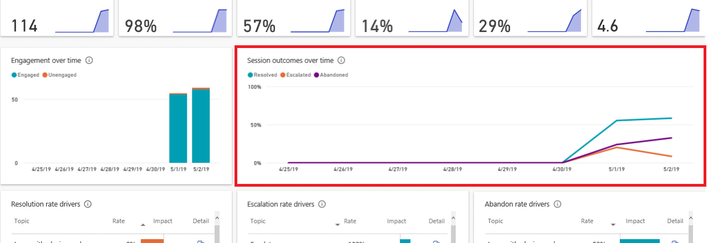
Monitor the ‘Session outcomes over time’ chart for trend changes

Slide 107
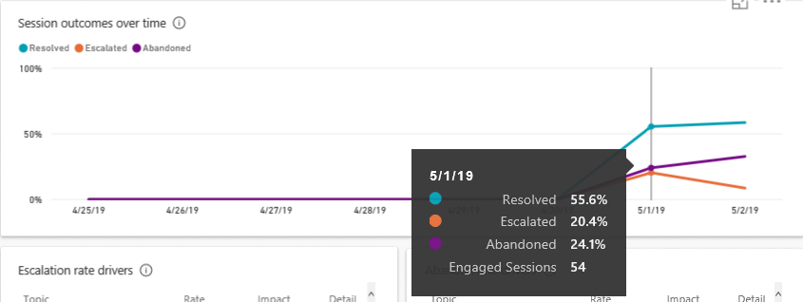
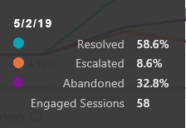
Pay attention to the purple line – Abandon rate is increasing!
Notes:
On 5/1 the abandon rate was 24.1%, on 5/2 it increased to 32.8%. At this point, find out the high abandon rate topic(s) and fix them.

Slide 108
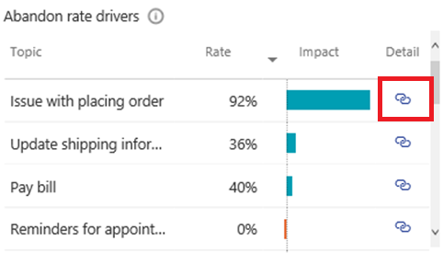
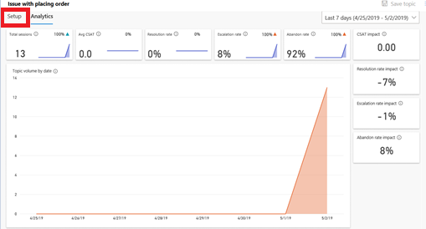
1. Identify high impact topics driving the abandon rate
2. Find more information about a topic by clicking ‘Detail’
3. Download and read the transcript history for this topic
4. Click 'Setup' to improve the topic content

Slide 109
Quiz time…

Slide 110
Q1: Which of the following answers is correct?
A. Engagement rate
B. Either Resolution rate or Escalation rate
If abandon rate increases, which rate will decrease?
C. Both Resolution rate and Escalation rate
D. Non-engagement rate

Slide 111
Answer:
A. Engagement rate
B. Either Resolution rate or Escalation rate
If abandon rate increases, which rate will decrease?
C. Both Resolution rate and Escalation rate
D. Non-engagement rate
Abandon rate + Resolution rate + escalation rate = 1

Slide 112
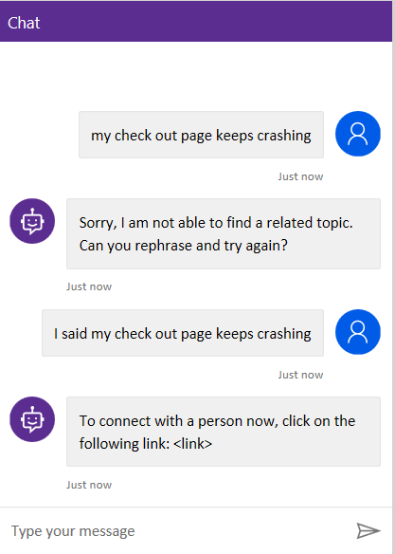
Q2: How would you improve this session?
A. Add new topics
B. Re-design this topic
C. Add more trigger phrases

Slide 113
Answer:
A. Add new topics
B. Re-design this topic
C. Add more trigger phrases

Slide 114
Q3: Which of the following statements is correct?
A. Adding a good variety of trigger phrases can help increase the resolution rate.
B. If the user reaches the ‘End of conversation’ but he/she does not respond to the survey, this will decrease the resolution rate.
C. Adding more escalate nodes in the conversation can increase the resolution rate.

Slide 115
Answer:
A. Adding a good variety of trigger phrases can help increase the resolution rate.
B. If the user reaches the ‘End of conversation’ but he/she does not respond to the survey, this will decrease the resolution rate.
C. Adding more escalate nodes in the conversation can increase the resolution rate.

Slide 116
Wrap up and next steps

Slide 117
The Road Ahead

Slide 118
Coming
Expand reach with support for new languages, channels, and telephony integration
Meet large enterprise needs through better IT manageability: Staging, application lifecycle
Enable bots to have more powerful conversations: Using global variables, deeper CDS integration, rich responses
Deeper Human + AI collaboration, continually suggesting new topics to automate as the bot gets used

Slide 119
Learn more about Microsoft Power Virtual Agents
Visit Power Virtual Agents to learn more and request a demo
Technical details about the application are available in our help documentation
For questions please engage in our Community forum

Slide 120
Lab Survey
We would appreciate your feedback on Power Virtual Agents and on this hands-on-lab, such as the quality of documentation and the usefulness of the learning experience.
Please use the survey at https://aka.ms/PVAiaDSurvey to share your feedback.
You may provide feedback for each module as you complete it or at the end once you’ve completed all the modules. Thank you!

Slide 121
DISCLAIMER
MICROSOFT POWER VIRTUAL AGENTS (1) IS NOT INTENDED OR MADE AVAILABLE AS A MEDICAL DEVICE FOR THE DIAGNOSIS OF DISEASE OR OTHER CONDITIONS, OR IN THE CURE, MITIGATION, TREATMENT OR PREVENTION OF DISEASE, OR OTHERWISE TO BE USED AS A COMPONENT OF ANY CLINICAL OFFERING OR PRODUCT, AND NO LICENSE OR RIGHT IS GRANTED TO USE MICROSOFT POWER VIRTUAL AGENTS FOR SUCH PURPOSES, (2) IS NOT DESIGNED OR INTENDED TO BE A SUBSTITUTE FOR PROFESSIONAL MEDICAL ADVICE, DIAGNOSIS, TREATMENT, OR JUDGMENT AND SHOULD NOT BE USED AS A SUBSTITUTE FOR, OR TO REPLACE, PROFESSIONAL MEDICAL ADVICE, DIAGNOSIS, TREATMENT, OR JUDGMENT, AND (3) SHOULD NOT BE USED FOR EMERGENCIES AND DOES NOT SUPPORT EMERGENCY CALLS. ANY CHATBOT YOU CREATE USING MICROSOFT POWER VIRTUAL AGENTS IS YOUR OWN PRODUCT OR SERVICE, SEPARATE AND APART FROM MICROSOFT POWER VIRTUAL AGENTS. YOU ARE SOLELY RESPONSIBLE FOR THE DESIGN, DEVELOPMENT, AND IMPLEMENTATION OF YOUR CHATBOT (INCLUDING INCORPORATION OF IT INTO ANY PRODUCT OR SERVICE INTENDED FOR MEDICAL OR CLINICAL USE) AND FOR EXPLICITLY PROVIDING END USERS WITH APPROPRIATE WARNINGS AND DISCLAIMERS PERTAINING TO USE OF YOUR CHATBOT. YOU ARE SOLELY RESPONSIBLE FOR ANY PERSONAL INJURY OR DEATH THAT MAY OCCUR AS A RESULT OF YOUR CHATBOT OR YOUR USE OF MICROSOFT POWER VIRTUAL AGENTS IN CONNECTION WITH YOUR CHATBOT, INCLUDING (WITHOUT LIMITATION) ANY SUCH INJURIES TO END USERS.

Slide 122
THANK YOU

